Slide 1
An Actor-based Modeling Language for Cyber-Physical Systems
Winter 2017

Slide 2
Outline
Introduction
Syntax
Semantic
Issues

Slide 3
Outline
Introduction
Syntax
Semantic
Issues

Slide 4
Cyber-Physical Systems
CPSs are integration of
  Computation
  Network
  Physical behaviors
Modeling interactions of these processes is a challenge

Slide 5
Hybrid Automata
A basic modeling language for CPSs
Consist of
  Locations and transitions for modeling discrete behaviors
  Differential equations for modeling continuous behaviors
Hard to model network communication and complex computations.

Slide 6
Actor-based Model
In CPSs controllers communicate through networks with each other.
Actors are unit of computations
  Execute concurrently
  Communicate through asynchronous message passing
Timed Rebeca an actor-based language
  Computation time
  Network delay
  Message deadline
  No continuous behavior

Slide 7
Hybrid Rebeca
Hybrid Rebeca modeling language
  Semantics based on hybrid automata
  Actor-based and asynchronous message passing
  Modeling continuous behaviors
  Modeling computation time.
  Modeling discrete behaviors

Slide 8
Outline
Introduction
Syntax
Semantic
Issues

Slide 9
Syntax
A model is consist of
  A number of Actor declarations
  A main block specifying initial messages to actors
An Actor declaration is consist of
  An identifier
  A number of variable (discrete or continuous)
  A number of method
A method has
  A name
  A sequence of statements

Slide 10
Statements
Discrete assignment
  dVar = dExpr
Continuous assignment
  cVar = cExpr
Condition
  if(dExpr) statements else statements

Slide 11
Statements
Send
  x.m()
Delay
  delay(r)
Continuous behavior
  inv(cExpr) ode guard(cExpr) statements

Slide 12
Example
Beverage machine specification
  Offers tea and coffee
  Temperature / Volume
    Tea: 100 / 300
    Coffee: 90 / 200

Slide 13
Actors
User for modeling ordering behavior
Machine as the main controller
Heater for heating the drink
Filler for filling the cup with the drink

Slide 14
User

Slide 15
Machine

Slide 16
Heater

Slide 17
Filler

Slide 18
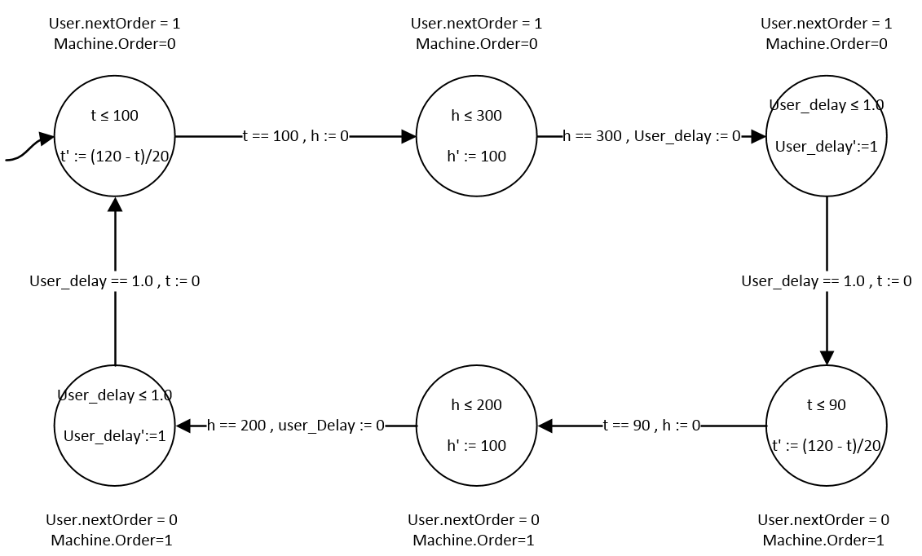
Translation

Slide 19
Outline
Introduction
Syntax
Semantic
Issues

Slide 20

Semantic
Two staged semantic
  Hybrid Rebeca to transition system
  Transition system to hybrid automata
Global state
  $l:ID →ActorState$
Actor state
  Valuation $v$
  High priority and low priority queues $q_{h},q_{l}$
  Statement queue $σ$
  Continuous behaviors $cs$

Slide 21
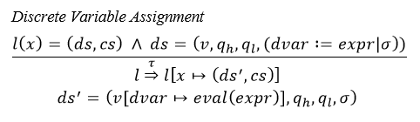

Transitions
Transitions are defined as SOS rules.
Two kind of label
  $τ$ transition: make the source state transient/urgent
  $guarded$ transition: guard of a continuous behavior

Slide 22
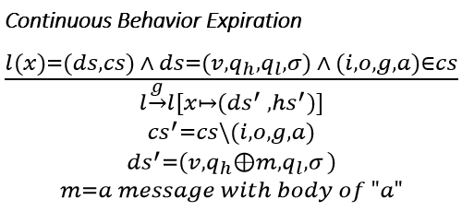
Transitions

Slide 23

Transition System
Transition system $TS=(l,→,l_{0})$
  $l$ is set of global states
  $→$ is the smallest relation defined by SOS rules
  $l_{0}$ is the initial state which
    Messages in main block are sent
    Initial values for discrete values are set

Slide 24

Hybrid Automaton
Applying following rules to transition system $TS=(l,→,l_{0})$
  Prioritizing $τ$ transitions: removing any guarded transition if state has any $τ$ transitions
  Merging $τ$ transitions: abstracting discrete behavior
Hybrid Automaton $HA\left(Loc,V,\left({loc}_{0},v_{0}\right),\underset{⇒}{ },I,F\right)$
  $Loc=l$
  $V$ set of all define continuous variables
  ${loc}_{0}$ = $l_{0}$
  $v_{0}$ initial values for continuous variables
  $\underset{⇒}{ } = →$
  $I\left(l\right)=logical conjunction of all invariants in l$
  $F\left(l\right)=set of all odes in l$

Slide 25
Draw Bridge Example
Draw bridge specification
  Default status is raised
  When a car enters the bridge, start lowering
  When lowered, cars start passing
  When all cars are passed, start raising
Actors
  CarDispatcher
  DrawBridge
  Bridge status
    0 : raised
    1 : raising/lowering
    2 : lowered

Slide 26
CarDispatcher

Slide 27
DrawBridge

Slide 28
DrawBridge

Slide 29
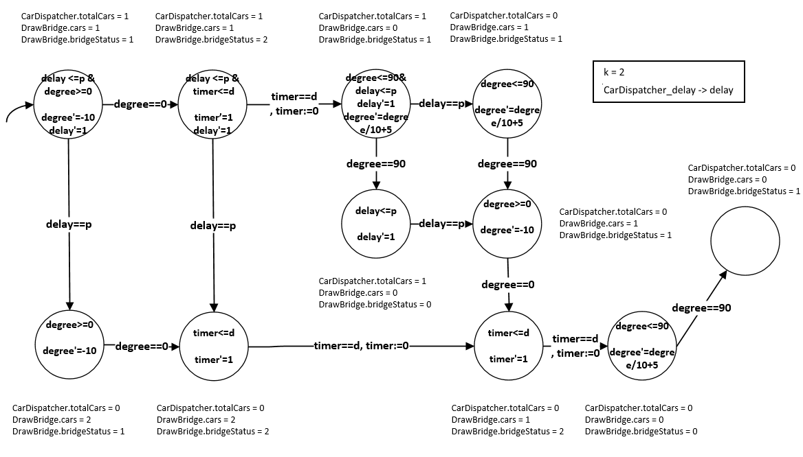
Translation

Slide 30
Outline
Introduction
Syntax
Semantic
Issues

Slide 31
Analysis
Currently discrete behaviors are abstracted in translated hybrid automaton
A framework for analyzing both discrete and continuous behavior is needed

Slide 32
Network Modeling
Only asynchronous message passing is defined.
Other network concepts needs to be defined
  Message delay (after)
  Message deadline

Slide 33
Interaction of Continuous and Discrete variables
Currently only continuous variables can be used in continuous behaviors.
What if invariant/guard needs to be defined on discrete variable
  In Draw Bridge Example StartRaising’s guard (degree == 90 || cars > 0)
Conditional statement on continuous variable
  if(degree > 0) doSomthing

